Slide 1

MERN Stack
Under the Guidance of Mrs. Amitha Mishra By, Professor, CSE Department. Thani Chandu
198R1A05N1

Slide 2
Introduction
MERN Stack
History of MERN Stack
Project Creation
Classifications of MERN Stack
Advantages and Disadvantages
conclusion

Slide 3
What is MERN Stack?
Frameworks available and is prevalent in MERN stack is an acronym for a full stack JavaScript framework consisting of MongoDB, Express.js, React, and Node.js. It is among the most common full stack eb development projects utilizing JavaScript.
Learning the MERN stack is an ideal way to start a career in full stack web development, though these are advanced skills, so you’ll need some existing programming knowledge.MERN is only one of several full stack development frameworks that coders can learn and use, so students will want to consider the kinds of projects they are working on when selecting the first framework to study.

Slide 4
History of MERN Stack
The individual elements of the MERN stack were each developed separately to address different development tasks commonly associated with JavaScript. Node.js was developed in 2009 to serve as a scalable run-time framework for running JavaScript code outside a web browser. Express.js was developed over a year later to serve as a de-facto server framework for Node.js applications. MongoDB was developed in 2009 to create a JavaScript native database documentation framework. React was introduced in 2013 as a framework for building and repurposing component UI elements.

Slide 5
Project Creation
Considering you’ve downloaded and configured all the four aforementioned technologies, you need to know how to create a new project folder to get started with the MERN stack. Next, you need to open the folder on the CMD (or terminal) and enter the following command to initialize a package.json file: npm init

Slide 6
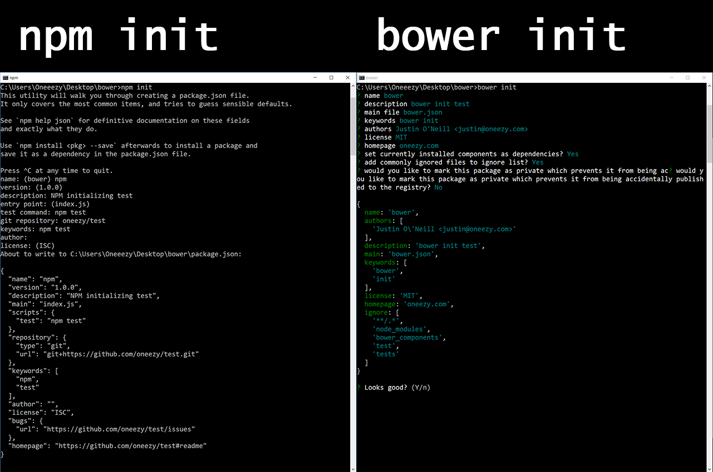

Slide 7
Classifications of MERN Stack
This kind of stack is used for building single-page applications. It means a web application that interacts with the user dynamically by just rendering the current page with requested data.
Ex: if you log in to your Gmail account (by default, the inbox page rendered while opening the Gmail page) and then tapping on the Sent mail section, it simply overwrites the Inbox column instead of opening the new window.
It consists of three parts:
Front End
Back End
Database

Slide 8
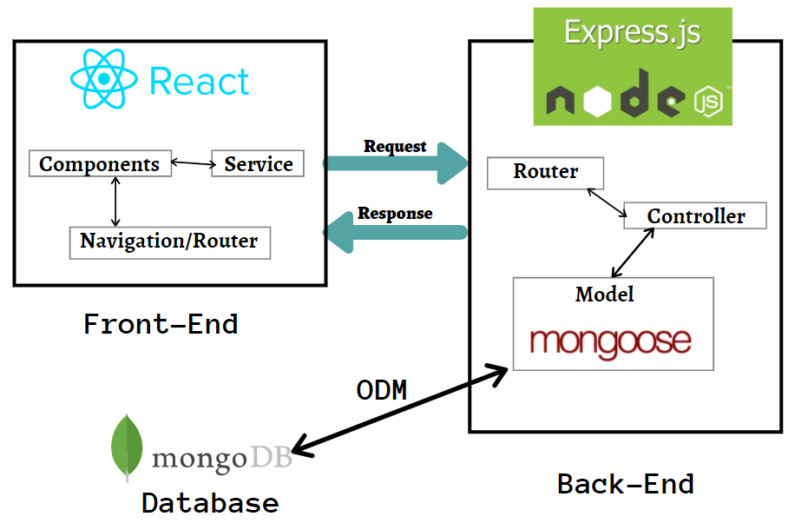
Architecture of MERN Stack

Slide 9
Front End
We know this part concentrate on user interaction. JS has a potential hand for event handling and loading all content in one web page due to DOM.
REACT –Pure UI: Component — related to appearance or rendering of the content.
Services — CRUD operations are done based on the user’s request and responses are rendered based on the result.
Navigation/router — navigation among various components. Eg: clicking on Submit button to render the landing page. We need this notable concept because single-page automation will render the component within the component.

Slide 10
Back End
This part contains Node.js, Express.js.
Node.js: Eg : Chrome — V8, Internet Explorer — Chakra, Edge — V8(chromium-based), Mozilla Firefox — Spider Monkey. Node.js is neither an application nor a framework. It’s just a runtime environment built on a standalone machine to interpret JavaScript code. It runs on top of the JavaScript Engine
Express.js
If a client need any data that is stored in a database, then the client will request that data by sending appropriate parameters. But these parameters are evaluated by Express.js before communicating to MongoDB. More specifically, data that are requested from react will hit the express.js

Slide 11
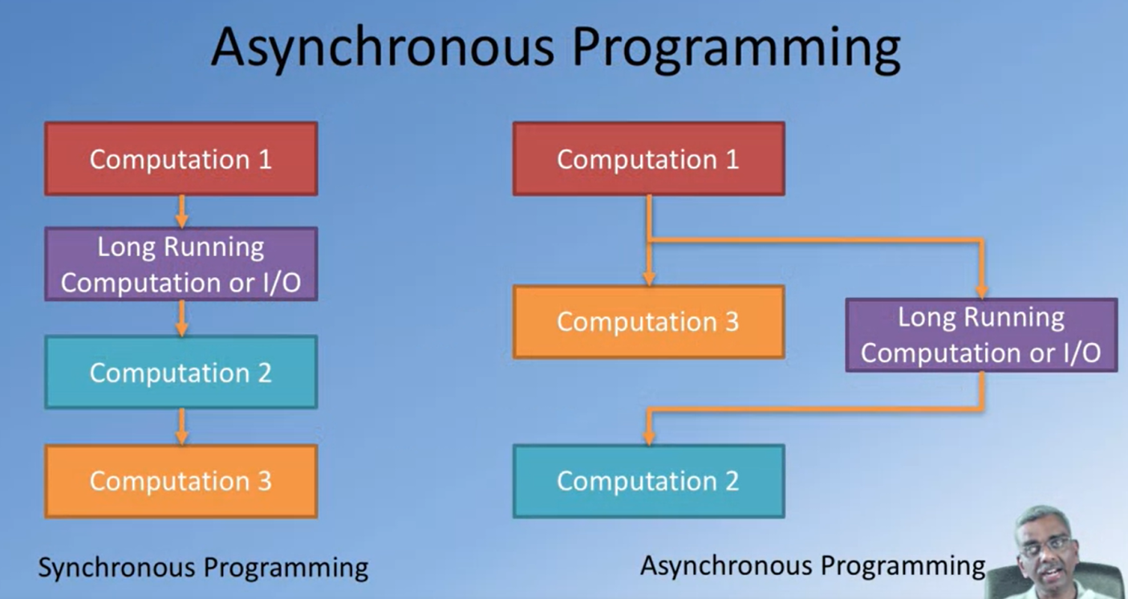

Slide 12
Database
We know MongoDB is No-SQL, non-relational database which means it stores data in JSON-like documents. Due to document-based, it is suitable for storing and managing unstructured data. MongoDB is a schema-less document-based database. From the model created, it will generate the schema and then it communicates with the database.
Data stored in the form of JSON –
Objects, Object Members, Arrays, Values, and Strings
JSON syntax is very easy to use.
JSON has a wide range of browser compatibility.
Sharing Data: Data of any size and type(video, audio) can be shared easily.

Slide 13
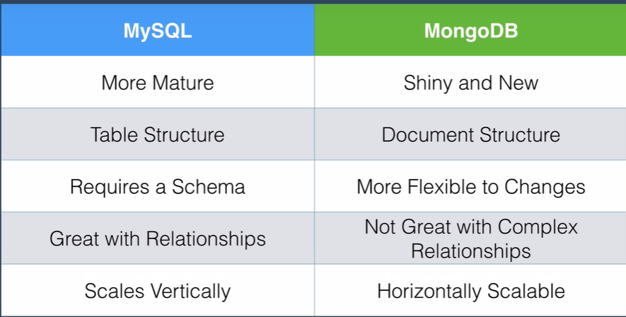
Difference between MySQL and MongoDB

Slide 14
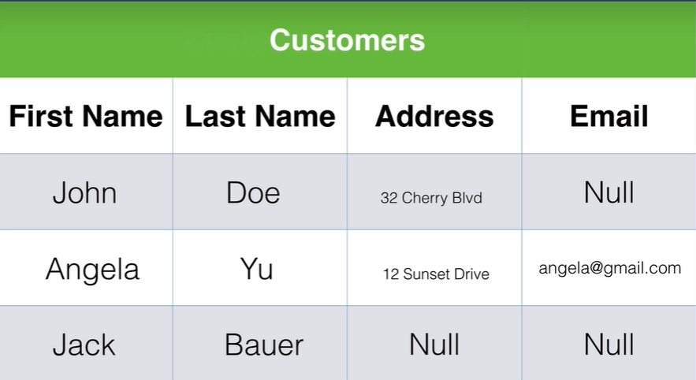
Limitations of MySQL (Relational Database)

Slide 15
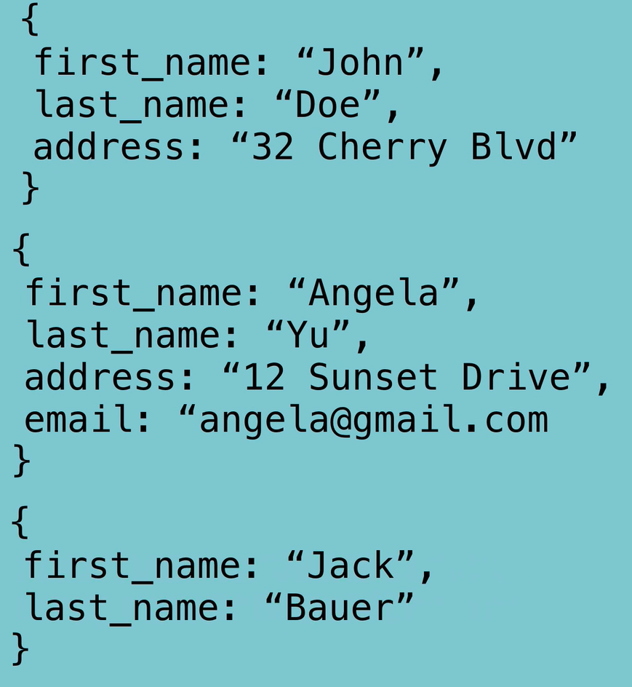
Advantages of MongoDB (non-Relational Database)

Slide 16
Advantages
It is an open-source framework utilized in developing dynamic websites and mobile apps. In other words, MERN is an assortment of four powerful technologies.
The combination of these technologies is called a “stack.” The MERN stack lets modern businesses create and implement robust apps.
Furthermore, MERN utilizes JavaScript for easier and quicker full stack web app development. This easy-to-understand full stack JavaScript framework includes

Slide 17
Disadvantages
Doing a large project with many developers becomes difficult with MERN. The MERN stack best serves Single-page applications.
React does not use typescript and it cannot prevents common coding errors by design.
One of the most frequently cited drawbacks of NoSQL databases is that they don't support ACID (atomicity, consistency, isolation, durability) transactions across multiple documents.

Slide 18
Conclusion
The demand for web developers has grown over 8 percent in the last decade. Web technology keeps advancing each day and there is a growing demand for seamless and enriching web applications. Developers have built different technology through which one can build interactive and responsive web applications. Popularly, web developers use Javascript and HTML to work on advanced technology like the MERN stack which is used to build highly robust full stack applications. In this article we will understand what the MERN stack is, and more about this popular and trending javascript stack.

Slide 19
Thank you.

